Slide 1
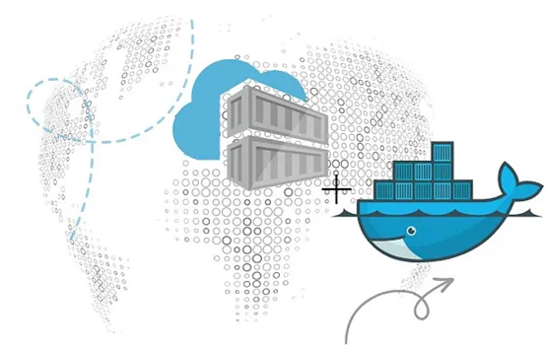
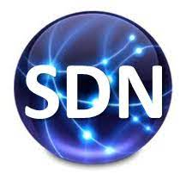
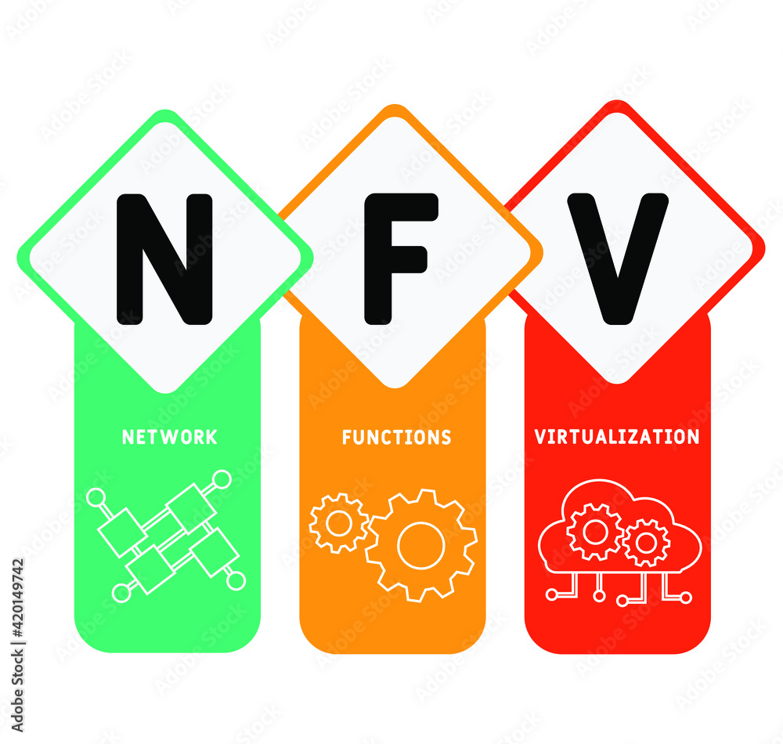
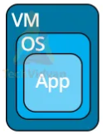
PDS
Computer Vision
Cloud
Computing
https://github.com/siagianp
https://www.youtube.com/@AmelOline/videos
https://github.com/amelcharolinesgn2/IoT_simulator-mqtt-NodeRed
https://github.com/amelcharolinesgn2/Cloud-Infrastructures
Notes:
https://docs.openstack.org/liberty/install-guide-rdo/overview.html
https://docs.openstack.org/liberty/install-guide-rdo/overview.html
[08.57, 25/8/2025] Del Gerry Wowiling: Sistem Komputasi Awan ya pak1.
https://roadmap.sh/aws
2. https://aws.amazon.com/what-is-cloud-computing/[08.58, 25/8/2025]
Del Gerry Wowiling:
3. https://www.ibm.com/topics/cloud-computing4. https://csrc.nist.gov/pubs/sp/800/145/final

Slide 2
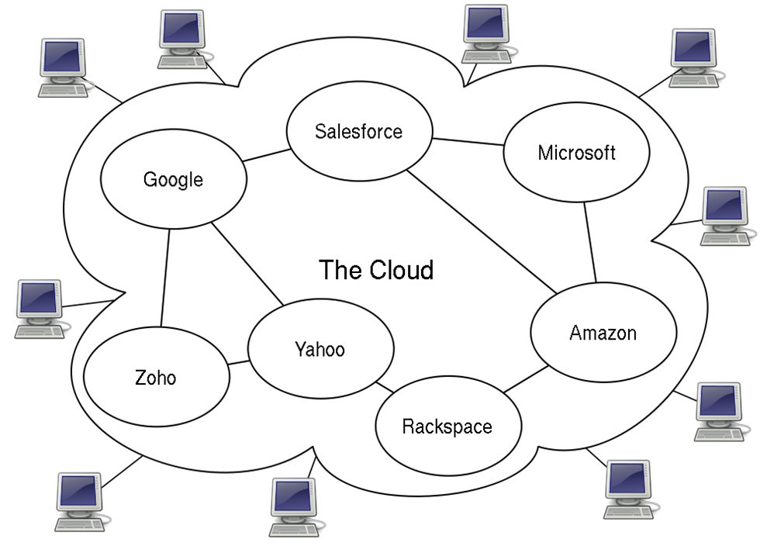
Cloud Computing

Slide 3
Definition
The National Institute of Standards and Technology (NIST) provides a concise and specific definition:
Cloud computing is a model for enabling convenient, on-demand network access to a shared pool of configurable computing resources (e.g., networks, servers, storage, applications, and services) that can be rapidly provisioned and released with minimal management effort or service provider interaction.

Slide 4
How it works
Utilizes the network as a means to connect user end point to resources that are centralized in a data center.
The data center may by accessed via the internet or a company network, or both.
Allows access from a variety of end points such as a mobile phone, a PC or a tablet.
Cloud services may be designed to be vendor agnostic, working equally well with Linux, Mac and PC platforms.

Slide 5
How it works
Allows access from any internet connected location, allowing Telecommuting, and Outsourcing.
A user endpoint with minimal software requirements may submit a task for processing. The service provider may pool the processing power of multiple remote computers in "the cloud" to achieve the task, such as data warehousing of hundreds of terabytes, managing and synchronizing multiple documents online, or computationally intensive work.

Slide 6
Comparison
Cloud computing shares characteristics with:
Autonomic computing
Client–server model
Grid computing
Mainframe computer
Utility computing
Peer-to-peer
Service-oriented computing

Slide 7
Architecture
Involves multiple components communicating with each other over application programming interfaces, usually web services and 3-tier architecture.
Multiple programs each doing one thing well and working together over universal interfaces.
Complexity is controlled and the resulting systems are more manageable than their monolithic counterparts.

Slide 8
Architecture
The two most significant components of cloud computing architecture are known as the front end and the back end.
The front end is the part seen by the client, i.e. the computer user. This includes the client’s network and applications used to access the cloud via a user interface such as a web browser.
The back end of the cloud computing architecture is the ‘cloud’ itself, comprising various computers, servers and data storage devices.

Slide 9
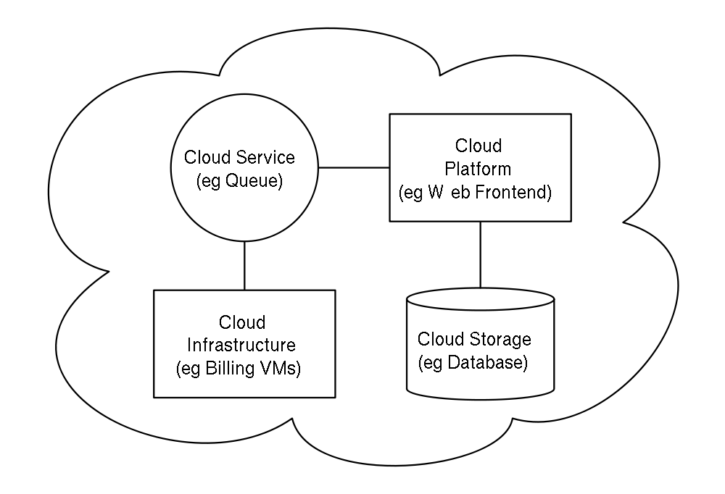
Architecture

Slide 10
Key characteristics
Agility improves with users' ability to rapidly and inexpensively re-provision technological infrastructure resources.
Application Programming Interface (API) accessibility to software that enables machines to interact with cloud software in the same way the user interface facilitates interaction between humans and computers.
Cost is claimed to be greatly reduced and in a public cloud delivery model capital expenditure is converted to operational expenditure.

Slide 11
Key characteristics
Device and location independence enable users to access systems using a web browser regardless of their location or what device they are using
Multi-tenancy enables sharing of resources and costs across a large pool of users thus allowing for:
Centralization of infrastructure in locations with lower costs
Peak-load capacity increases
Utilization and efficiency improvements for systems that are often only 10–20% utilized.

Slide 12
Key characteristics
Reliability is improved if multiple redundant sites are used, which makes cloud computing suitable for business continuity and disaster recovery.
Scalability via dynamic "on-demand" provisioning of resources on a fine-grained, self-service basis near real-time.
Performance is monitored, and consistent and loosely coupled architectures are constructed using web services as the system interface.
Security could improve due to centralization of data.

Slide 13
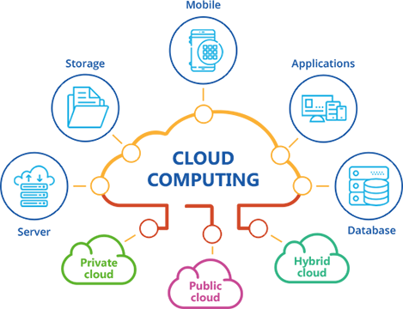
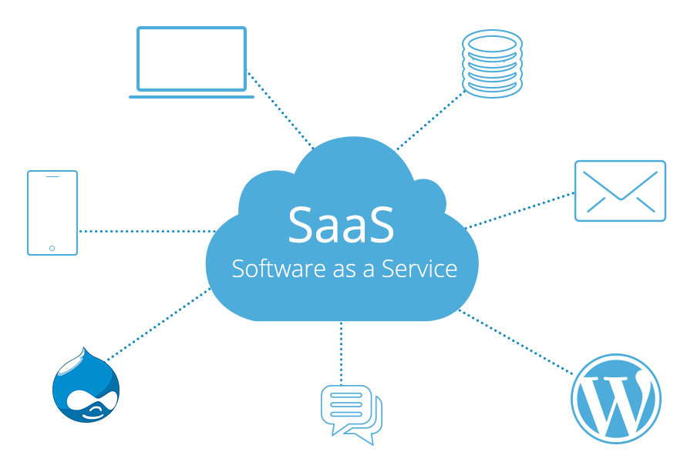

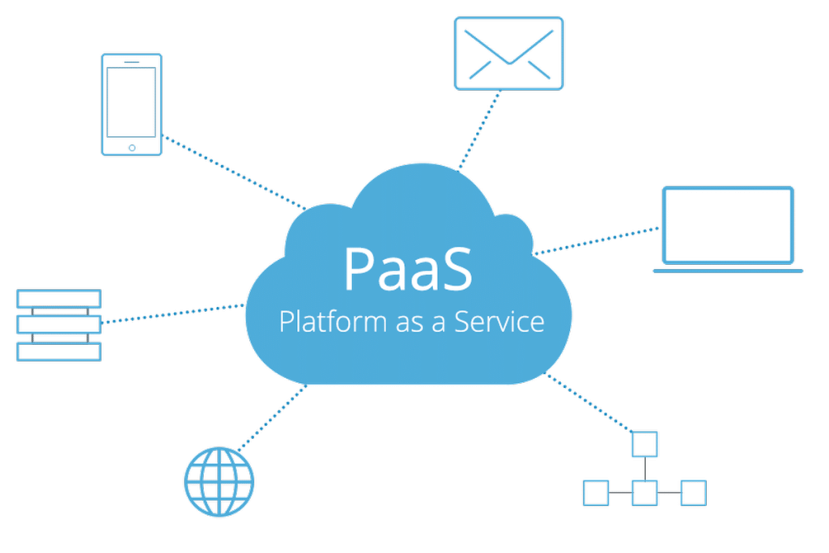
Service Models
There are three types of the cloud:
Infrastructure as a Service (IaaS)
Platform as a Service (PaaS)
Software as a Service (SaaS)

Slide 14
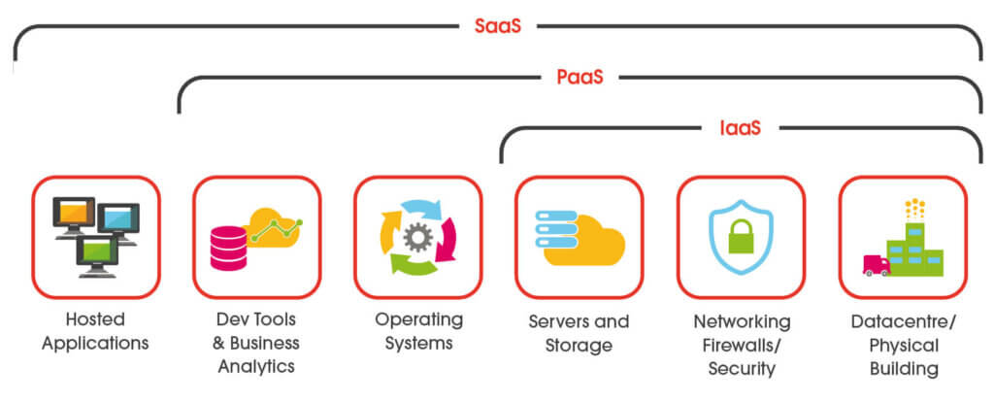
Service Models

Slide 15
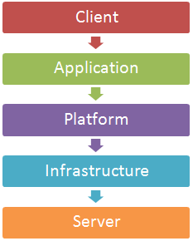
Layers
Client
Application
Platform
Infrastructure
Server

Slide 16
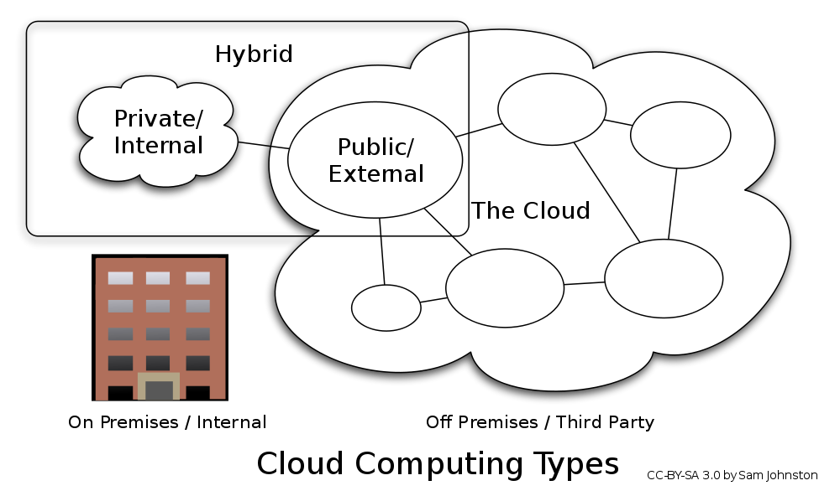
Deployment models
Public cloud
Community cloud
Hybrid cloud and hybrid IT delivery
Combined cloud
Private cloud

Slide 17
Why use cloud computing
Website traffic fluctuates.
Visitors expect steady, fast performance regardless.
An infrastructure able to handle peak traffic requires capital investment.
No matter how big you build it, it still may not be enough.
Having to choose between overspending or under-provisioning is a classic dilemma.
By deploying your web application in the cloud, you can avoid this dilemma. You can eliminate the upfront fixed investment, and still gain access to compute resources to meet peak loads with on demand scalability, while still paying only for the compute time you actually use.

Slide 18
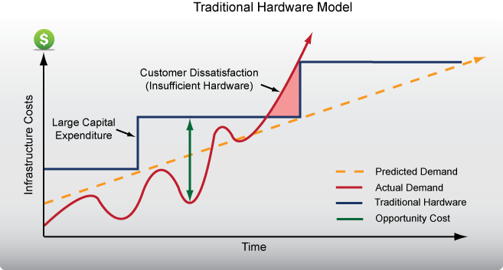
Why use cloud computing

Slide 19
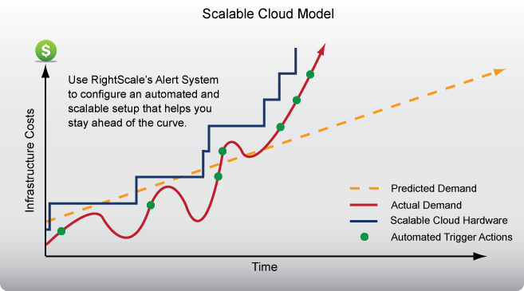
Why use cloud computing

Slide 20
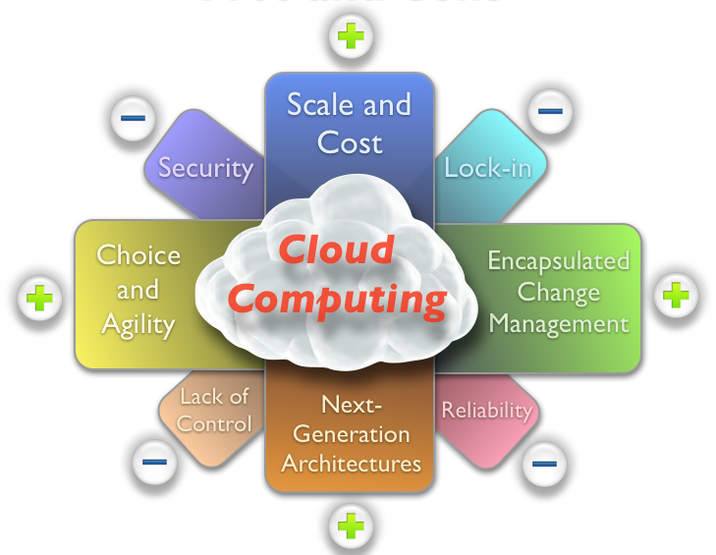
Pros and Cons

Slide 21
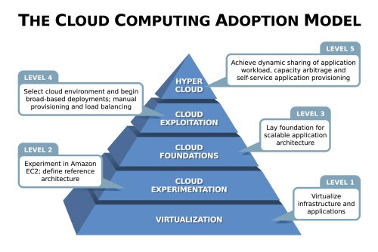
CCAM

Slide 22
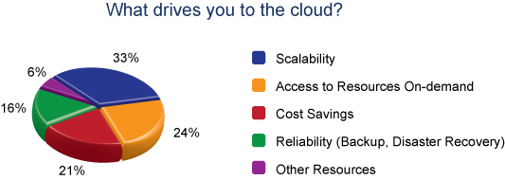
Selection Factors

Slide 23
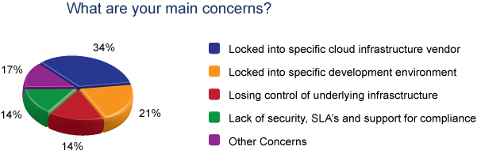
Main Concerns

Slide 24
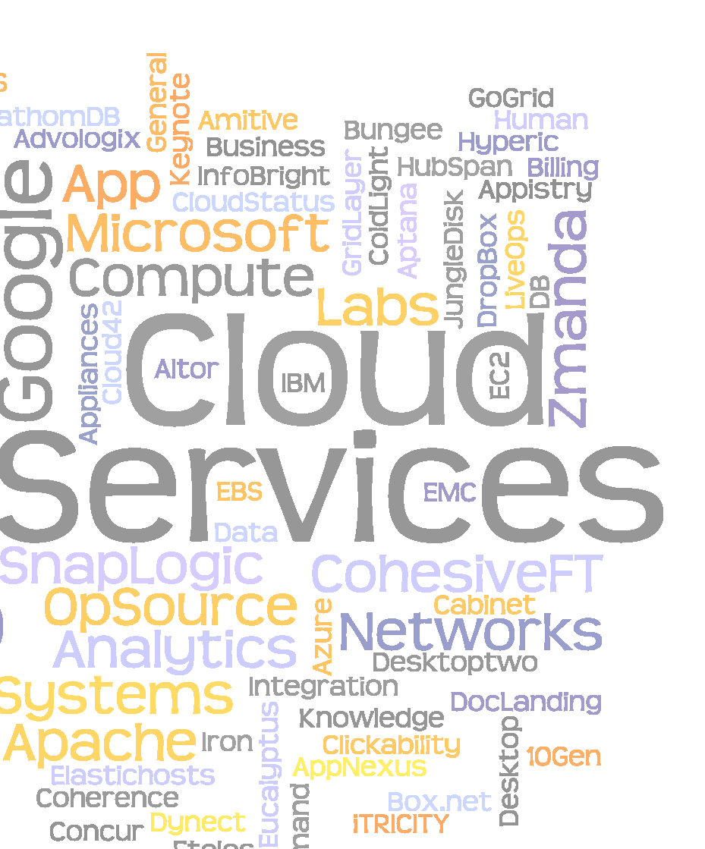
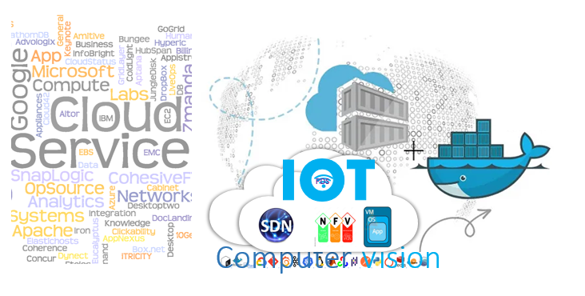
Questions?
PDS
Computer Vision

Slide 25
Referensi
https://docs.openstack.org/liberty/install-guide-rdo/overview.html
https://compas.cs.stonybrook.edu/cse356-v3
https://compas.cs.stonybrook.edu/~mferdman/#teaching

